Slide 1

Customer Shopping Behavior Analysis
3,900 purchases • 18 columns • goal: uncover spending patterns, segments, preferences, subscriptions

Slide 2
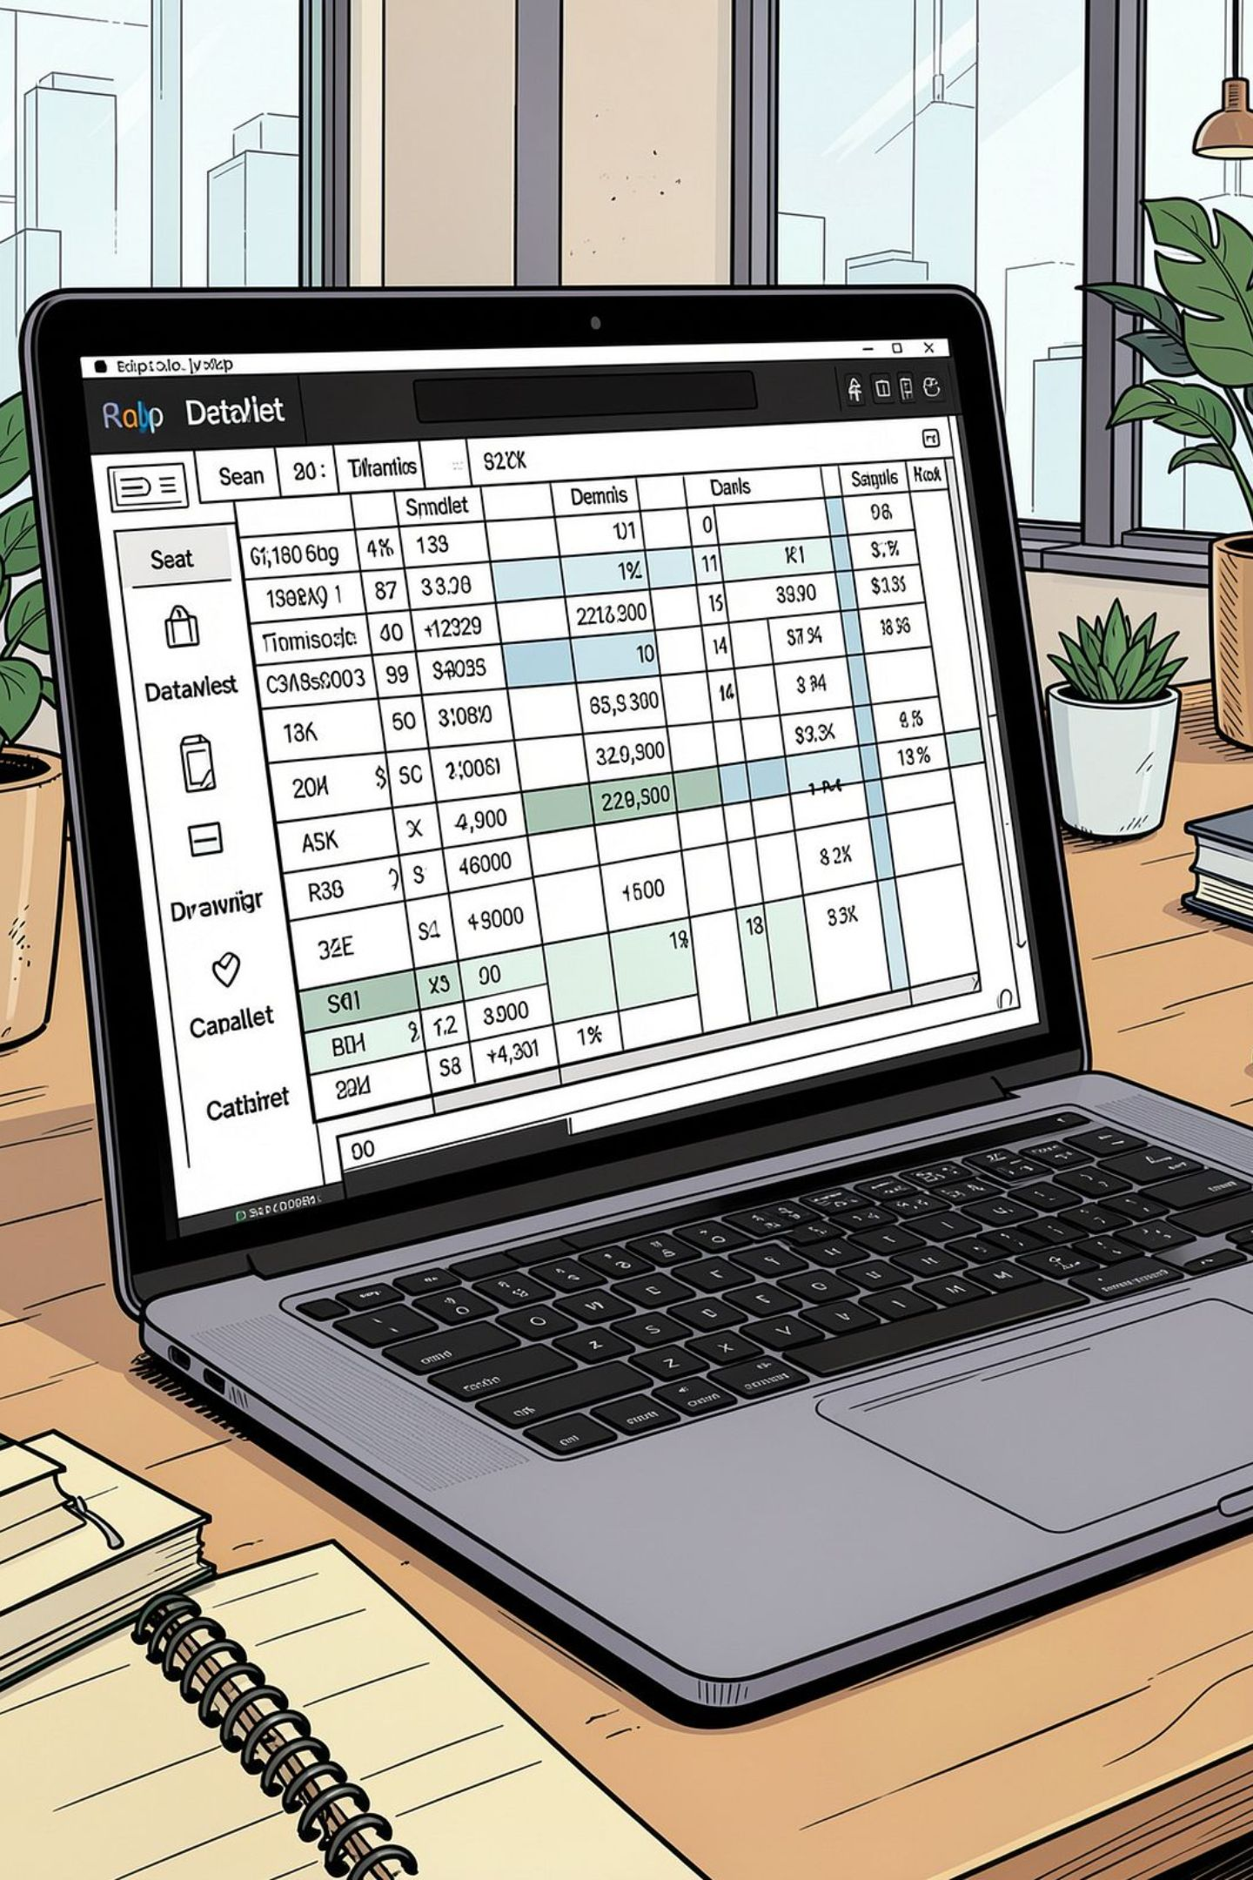
Dataset Snapshot
Rows & Columns
Key Features
3,900 rows · 18 columns
Demographics, purchase details, behavior metrics
Missing Data
37 missing values in Review Rating

Slide 3
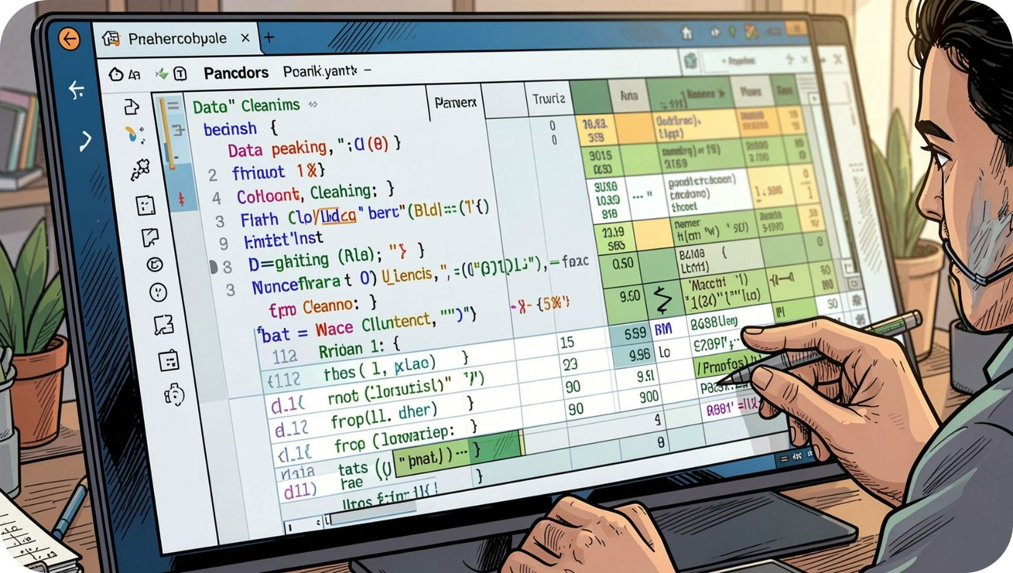
Data Preparation (Python)
01
02
Load & Inspect
Impute
pandas: df.info(), .describe()
Review Rating → median by category
03
04
Standardize
Engineer
Rename to snake_case
age_group, purchase_frequency_days

Slide 4
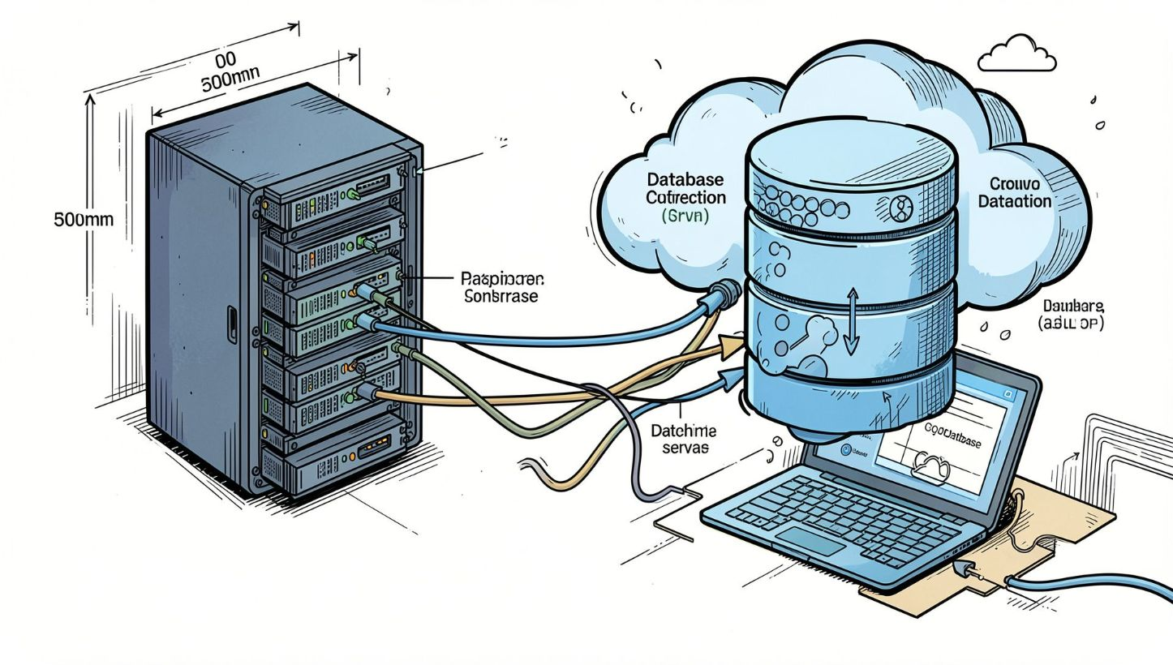
Pipeline: Python → PostgreSQL
Cleaned DataFrame loaded to PostgreSQL for SQL analysis
Verified redundancy: dropped promo_code_used
Enabled business-querying of transactions

Slide 5
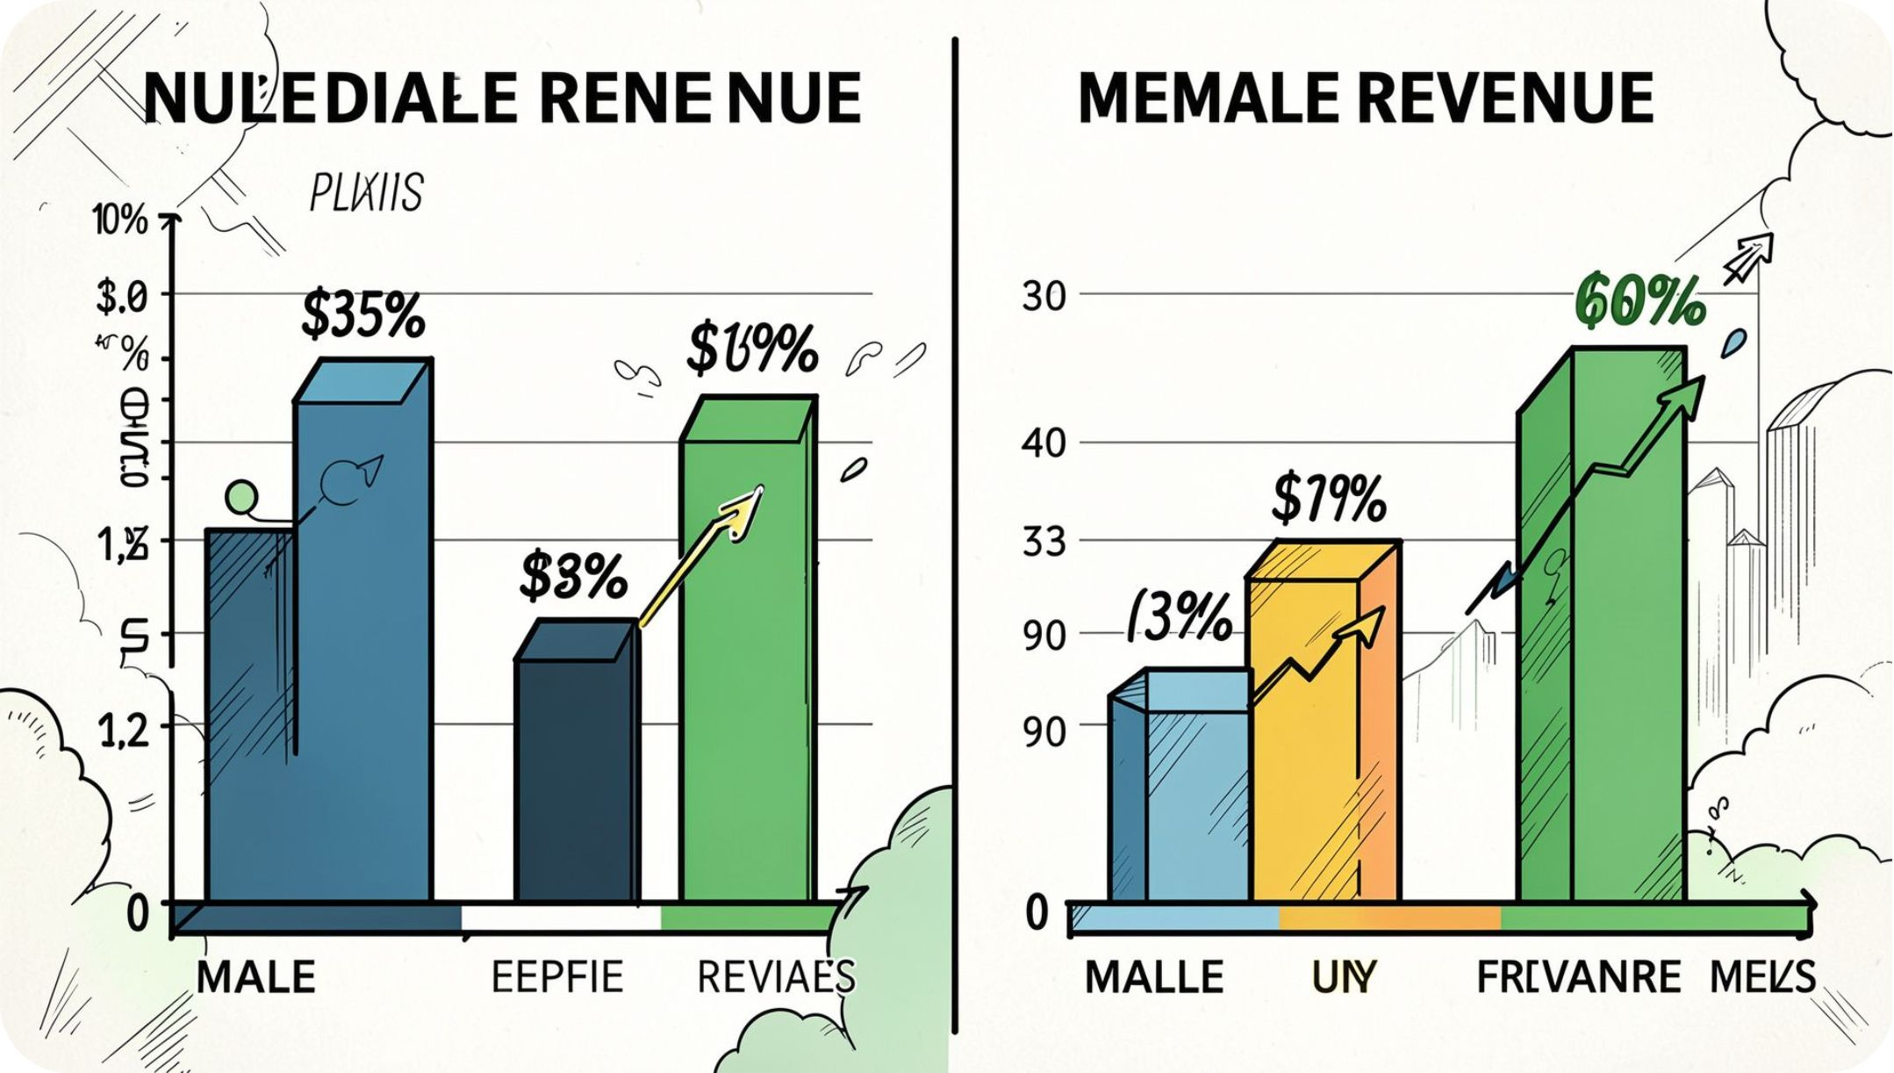
Revenue & Demographics
Revenue by Gender — compare totals
Revenue by Age Group — identify high-revenue cohorts
Use insights to target marketing spend

Slide 6
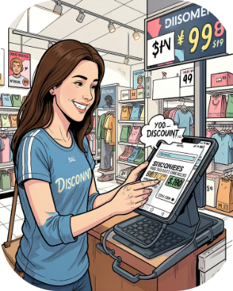
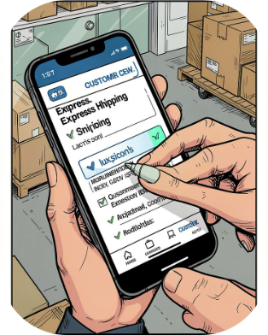
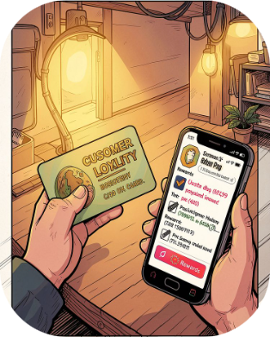
Behavioral Insights
High-Spend Discount Users
Shipping Preference
Segments
Compare Standard vs Express average spend
New · Returning · Loyal (based on purchase history)
Customers using discounts but spending above average

Slide 7
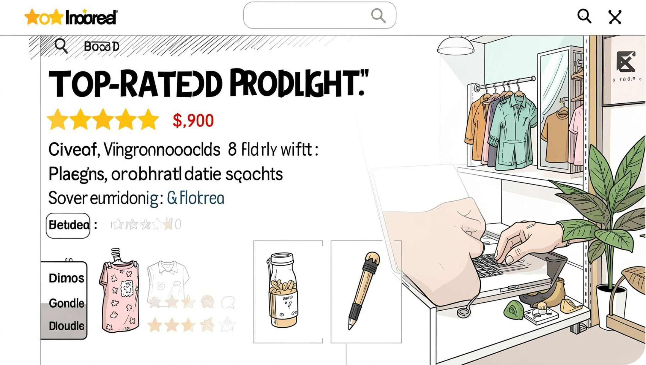
Product Performance
Top 5 products by average rating
Top 3 products per category (most purchased)
Discount-dependent products: 5 items with highest % discounted purchases

Slide 8
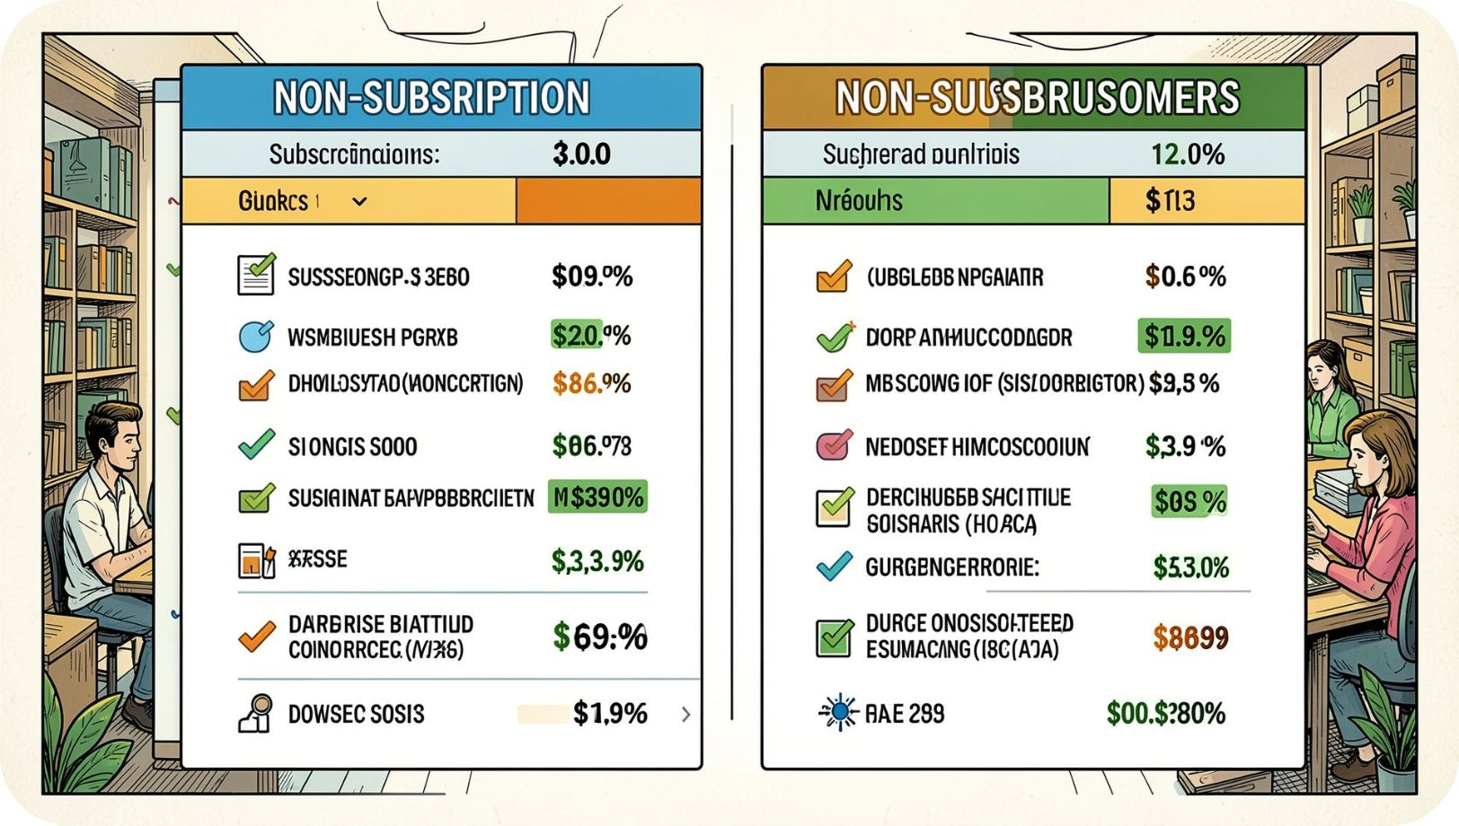

Subscriptions & Repeat Buyers
Subscribers vs Non-Subscribers: avg spend & total revenue
Repeat buyers (>5 purchases) → likelihood to subscribe
Insight: repeat buyers more likely to convert to subscribers

Slide 9
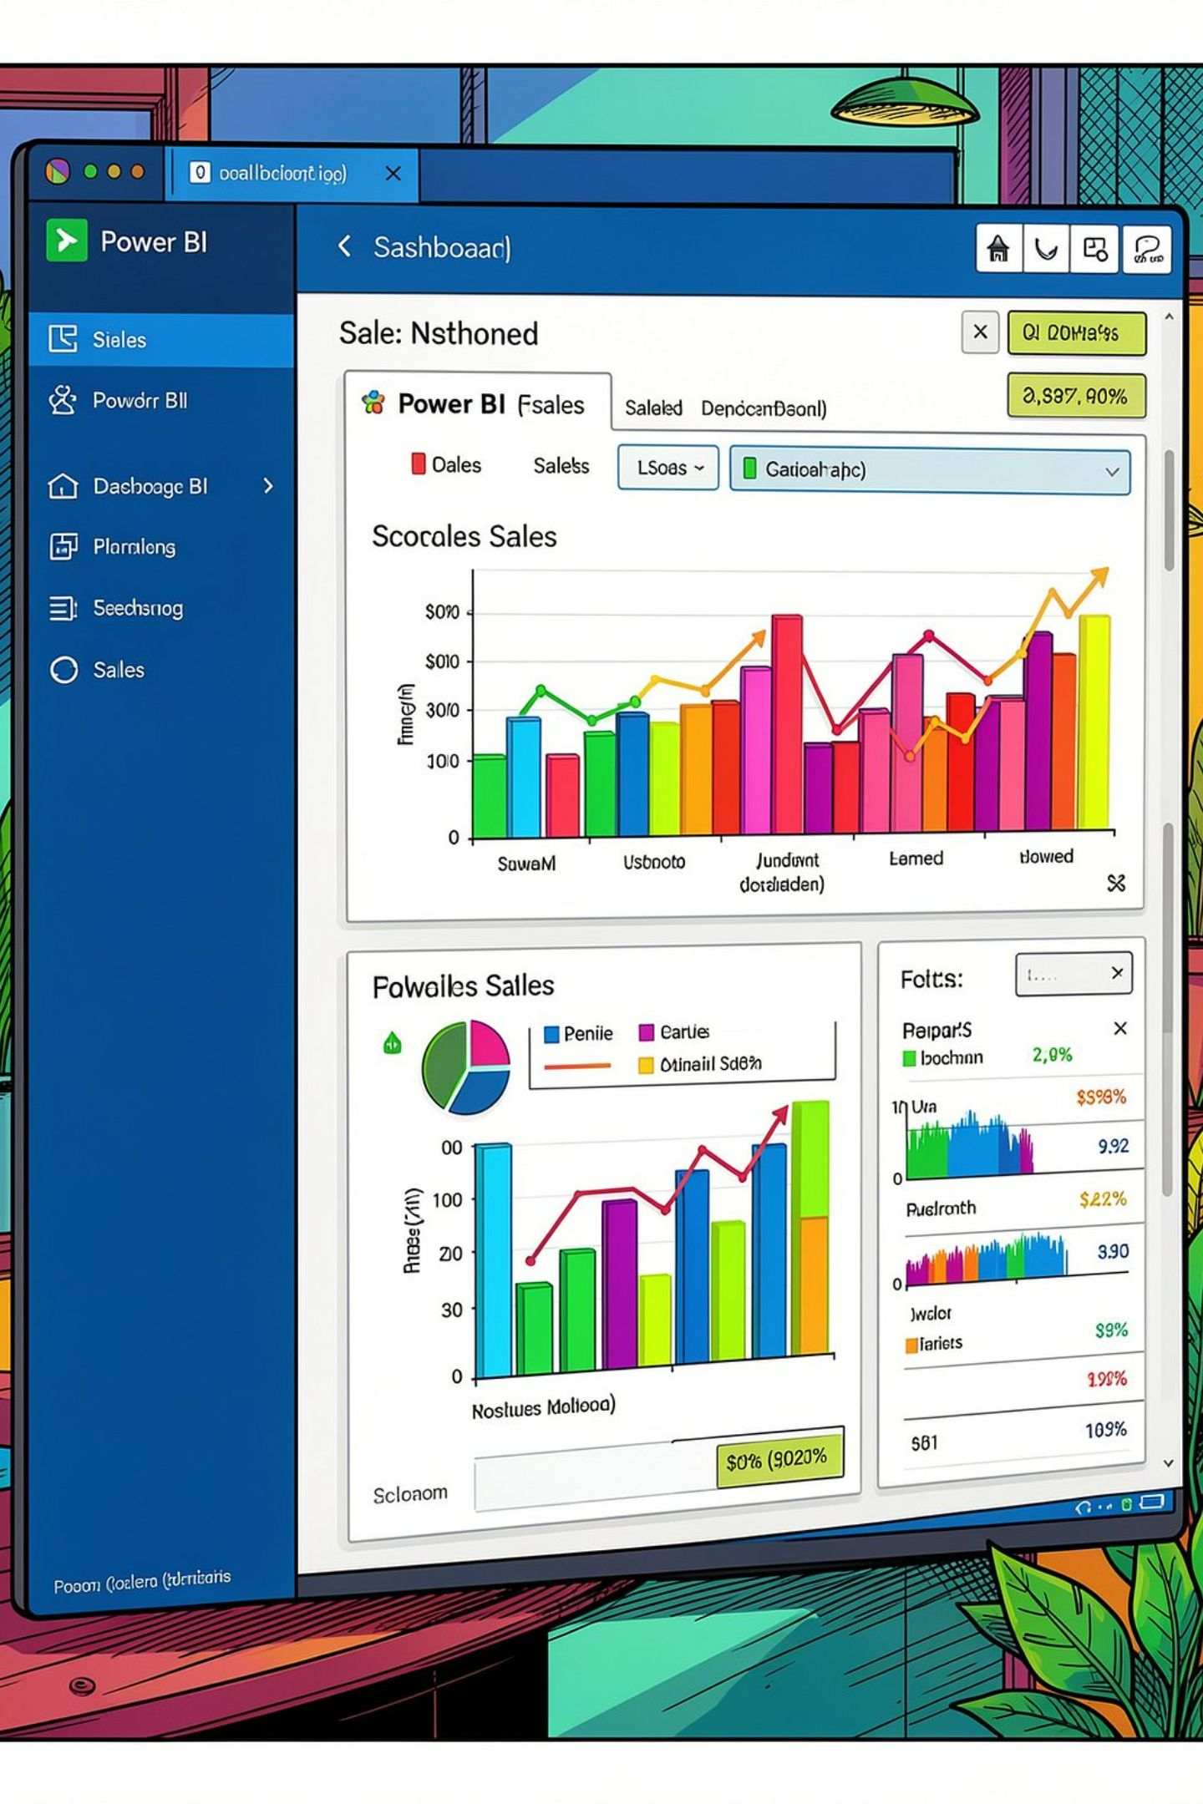
Dashboard & Visualization
Power BI dashboard built to explore: revenue, segments, product performance, shipping, discounts

Slide 10





Business Recommendations
Boost Subscriptions
Customer Loyalty Programs
Promote exclusive benefits for subscribers
Reward repeat buyers to grow "Loyal" segment
Review Discount Policy
Product Positioning & Targeting
Balance short-term sales with margin control
Feature top-rated & best-selling items; focus on high-revenue ages and express-shipping users

